Slide 1
Problem Statement
What opportunities exist for Big Mountain Resort to select a better value for their ticket prices?
H
1
Context
4
Constraints within solution space
Big Mountain Resort, a ski and snowboard resort located in Montana near Glacier National Park. To make the best use of facilities and maximize revenue, the business wants data-driven guidance for ticket pricing.
Data about competitors is limited to their facilities and base ticket price, not number of visitors or address
Data about Big Mountain Resort is limited also - no information about which facilities people use or their other consumer behavior, such as day-visits versus multi-day stays
2
Criteria for success
5
Stakeholders to provide key insight
Avoid undermining ticket price
Evaluate how important some facilities are compared to others
Analysis report delivered by __date _.
Known contacts:
Director of Operations, Jimmy Blackburn
Database Manager, Alesha Eisen
Desired additional contacts: managers of the various facilities at Big Mountain Resort, local chamber of commerce for tourism data
3
Scope of solution space
6
Key data sources
This analysis focuses on a pricing model for Big Mountain Resort.
Efforts to cut costs or change operations are outside the scope of this analysis.
Known data:
CSV file with facility and competitor info
Desired data:
Financial systems- number of tickets on which days of week, consumer repeat purchases, etc
Logs from equipment
Tourism market size and trends
H
D
E
I
P
Notes:
Hypothesis: Create a Hypothesis with an emphasis on SMART principles. (S – Specific, M – Measurable, A – Achievable, R – Realistic, T – Timebound). If you cannot do this, you do not have a good grasp on the business problem.
Context: With context, we have clearly identified the problem at hand and have elucidated on how our initiative may solve this problem, alongside the commercial implications this will have on the business.
Criteria for Success: Clearly defining the criteria for success ensures that the scope of your work is clearly defined and understood. Otherwise, if this isn’t defined – your work will never end which will result in mismatched expectations.
Scope of Solution Space: Scoping out the solution space ensures that the business initiative is SPECIFIC for a certain segment or area. This prevents solutions that have been developed being scaled and applied for all other business units that the solution may not be responsible or scalable for.
Constraints within Solution Space: Looking forward, what are the foreseeable problems we are likely to encounter? Could this be stakeholder resistance? Could this be we don’t have access to the right data?
Stakeholders to provide key insight: Who are the people I need to speak to, to get the answers I need for my data analysis?
What key data sources are required?
Based off my discussions with the key stakeholders – can we clearly list out all the data sources we need so we can make a highly targeted request as opposed to a scatter-gun approach where we ask for a bit of everything?

Slide 2
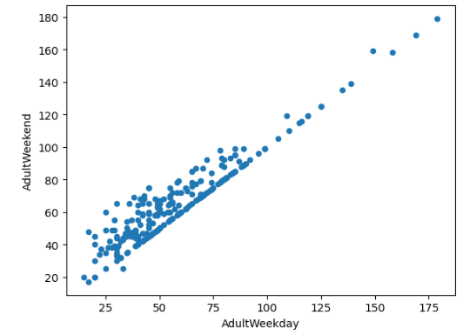
Data Wrangling
Collecting the data, organizing it, and making sure it's well defined.
D
1
Data starting point
Montana is in the top 5 ski states in the US
Big Mountain Resort management provided a CSV file, ski_resort_data.csv, with facilities and ticket price information for ski resorts throughout the US.
For number of resorts and skiable acres.
In Exploratory data
State | Resorts per State | State Skiable acres
Colorado | 22 | 43,682
Utah | 13 | 30,508
California | 21 | 25,948
Montana | 12 | 21,410
Idaho | 12 | 16,396
2
Evaluate existing data
330 rows, corresponding to 330 ski resorts across the US.
Initial summary and descriptive statistics
By-state evaluation
Integrated state population and area data from Wikipedia
4
What about Weekend vs Weekday price?
In Montana, weekday and weekend ticket prices are equal - not so in all states.
Since there are fewer missing values in the data set for weekend ticket prices, the analysis will continue wiith weekend ticket price
3
Initial Data Cleansing
Identify missing data and outliers
Dropped rows with no price data
Investigated outlier data with outside sources, edited in local table
H
D
E
I
P
Notes:
Hypothesis: Create a Hypothesis with an emphasis on SMART principles. (S – Specific, M – Measurable, A – Achievable, R – Realistic, T – Timebound). If you cannot do this, you do not have a good grasp on the business problem.
Context: With context, we have clearly identified the problem at hand and have elucidated on how our initiative may solve this problem, alongside the commercial implications this will have on the business.
Criteria for Success: Clearly defining the criteria for success ensures that the scope of your work is clearly defined and understood. Otherwise, if this isn’t defined – your work will never end which will result in mismatched expectations.
Scope of Solution Space: Scoping out the solution space ensures that the business initiative is SPECIFIC for a certain segment or area. This prevents solutions that have been developed being scaled and applied for all other business units that the solution may not be responsible or scalable for.
Constraints within Solution Space: Looking forward, what are the foreseeable problems we are likely to encounter? Could this be stakeholder resistance? Could this be we don’t have access to the right data?
Stakeholders to provide key insight: Who are the people I need to speak to, to get the answers I need for my data analysis?
What key data sources are required?
Based off my discussions with the key stakeholders – can we clearly list out all the data sources we need so we can make a highly targeted request as opposed to a scatter-gun approach where we ask for a bit of everything?

Slide 3
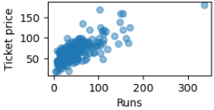
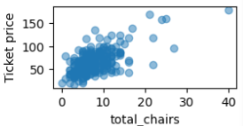
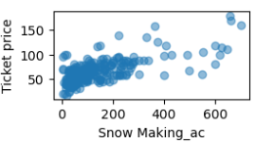
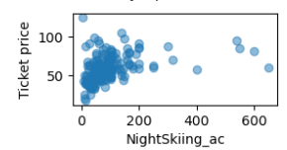
Exploratory Data Analysis
Which ski resort features are related to difference in price?
E
1
Montana is in the top 5 ski states in the US
3
Resort Features
For number of resorts and skiable acres, but 27th in average ticket price.
At $81, Big Mountain Resort is priced at a 36% premium over Montana’s average price.
State | Resorts per State | State Skiable acres | Average Ticket Price | Price Rank in US
Colorado | 22 | 43,682 | $93.00 | 2
Utah | 13 | 30,508 | $90.71 | 1
California | 21 | 25,948 | $81.42 | 5
Montana | 12 | 21,410 | $51.91 | 27
Idaho | 12 | 16,396 | $55.90 | 24
Linear relationships between resort features and price yielded several interesting possibilities for building a price prediction model:
2
Evaluate by state
Using the state population data, considered:
State size, population, resorts per state
Total skiable area, night skiing area
Days open
Resort density
Per-state measurements were not conclusive
Proceed with the following features and request number of visitors per year
Vertical_drop
fastQuads
Runs
total_chairs
H
D
E
I
P
Notes:
Hypothesis: Create a Hypothesis with an emphasis on SMART principles. (S – Specific, M – Measurable, A – Achievable, R – Realistic, T – Timebound). If you cannot do this, you do not have a good grasp on the business problem.
Context: With context, we have clearly identified the problem at hand and have elucidated on how our initiative may solve this problem, alongside the commercial implications this will have on the business.
Criteria for Success: Clearly defining the criteria for success ensures that the scope of your work is clearly defined and understood. Otherwise, if this isn’t defined – your work will never end which will result in mismatched expectations.
Scope of Solution Space: Scoping out the solution space ensures that the business initiative is SPECIFIC for a certain segment or area. This prevents solutions that have been developed being scaled and applied for all other business units that the solution may not be responsible or scalable for.
Constraints within Solution Space: Looking forward, what are the foreseeable problems we are likely to encounter? Could this be stakeholder resistance? Could this be we don’t have access to the right data?
Stakeholders to provide key insight: Who are the people I need to speak to, to get the answers I need for my data analysis?
What key data sources are required?
Based off my discussions with the key stakeholders – can we clearly list out all the data sources we need so we can make a highly targeted request as opposed to a scatter-gun approach where we ask for a bit of everything?

Slide 4
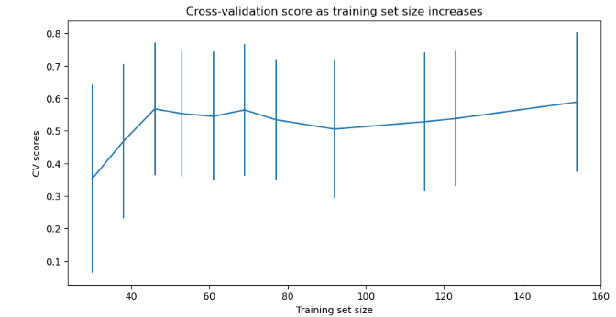
Preprocessing and Training
Can the data be used to build a model that predicts ticket price?
I
1
Data preparation and initial statistics
3
Refine the linear model
Split the data into training and testing sets. Evaluate whether the mean is a good predictor
Use R² to measure the proportion of variance
Summarize the difference between predicted and actual values:
Mean absolute error (MAE) : on average, you might expect to be off by around $19 if you guessed ticket price based on an average of known values.
Mean squared error (MSE) and root mean square error:you might expect to be off by around $25
Check for overfitting (fitting the training data so closely that it will fail to fit or predict additional or future data)
Select the best features based on univariate statistical tests
Cross-validate using random forest regressor
With and without feature scaling
Mean and median for imputing missing values
The dominant top four features are in common with the linear model:
fastQuads, Runs, Snow Making_ac, vertical_drop
4
Evaluate whether more data is needed to confirm model performance
Cross-validation score peaks at a training test size of between 40 - 50. This data set is large enough.
2
Data preparation
Impute missing values
Test with mean and median - in this case, no difference
Scale the data so values are comparable:
Zero mean and zero unit variance
H
D
E
I
P
Notes:
Hypothesis: Create a Hypothesis with an emphasis on SMART principles. (S – Specific, M – Measurable, A – Achievable, R – Realistic, T – Timebound). If you cannot do this, you do not have a good grasp on the business problem.
Context: With context, we have clearly identified the problem at hand and have elucidated on how our initiative may solve this problem, alongside the commercial implications this will have on the business.
Criteria for Success: Clearly defining the criteria for success ensures that the scope of your work is clearly defined and understood. Otherwise, if this isn’t defined – your work will never end which will result in mismatched expectations.
Scope of Solution Space: Scoping out the solution space ensures that the business initiative is SPECIFIC for a certain segment or area. This prevents solutions that have been developed being scaled and applied for all other business units that the solution may not be responsible or scalable for.
Constraints within Solution Space: Looking forward, what are the foreseeable problems we are likely to encounter? Could this be stakeholder resistance? Could this be we don’t have access to the right data?
Stakeholders to provide key insight: Who are the people I need to speak to, to get the answers I need for my data analysis?
What key data sources are required?
Based off my discussions with the key stakeholders – can we clearly list out all the data sources we need so we can make a highly targeted request as opposed to a scatter-gun approach where we ask for a bit of everything?

Slide 5
Predictions from the model
Can the model be used to answer business questions?
P
1
Calculate Expected Big Mountain Ticket Price From The Model
3
Evaluate business questions against the model
A first cut – be skeptical:
Big Mountain Resort modelled price is $94.58; currentl price is $81.00.
Even with the expected mean absolute error of $10.29, this suggests there is room for an increase.
Calculate changes to ticket price and revenue based on each option.
The expected number of visitors over the season is 350,000 and on average, visitors ski for five days.
Close runs? Impact varies by number of runs closed. Closing 1 run makes no difference; between 3 - 5 runs, affects revenue -$1.6 million; . 6 or more -$1.8 to -$ 2.1 million..
Add a run, increase the vertical drop by 150 feet, install an additional chair lift.
This scenario increases support for ticket price by $1.31
Over the season, this could be expected to amount to $2,295,082
Model 2 plus 2 acres of snow making.
Same revenue impact as model 2.
2 act of snow making does not shift ticket prices in this model.
Increasing the longest run by .2 miles and guaranteeing its snow coverage by adding 4 acres of snow making.
$0 change to the ticket price or revenue
2
Business questions
Do any of these scenarios (aimed at cutting costs or increasing revenue) affect predicted ticket prices per the model?
Permanently closing down up to 10 of the least used runs. This doesn't impact any other resort statistics.
Increase the vertical drop by adding a run to a point 150 feet lower down but requiring the installation of an additional chair lift to bring skiers back up, without additional snow making coverage
Same as number 2, but adding 2 acres of snow making cover
Increase the longest run by 0.2 mile to boast 3.5 miles length, requiring an additional snow making coverage of 4 acres
4
Further work
Adding chair lifts
Selling more tickets
Other data about customers to increase revenue or drive down costs
H
D
E
I
P
Notes:
Hypothesis: Create a Hypothesis with an emphasis on SMART principles. (S – Specific, M – Measurable, A – Achievable, R – Realistic, T – Timebound). If you cannot do this, you do not have a good grasp on the business problem.
Context: With context, we have clearly identified the problem at hand and have elucidated on how our initiative may solve this problem, alongside the commercial implications this will have on the business.
Criteria for Success: Clearly defining the criteria for success ensures that the scope of your work is clearly defined and understood. Otherwise, if this isn’t defined – your work will never end which will result in mismatched expectations.
Scope of Solution Space: Scoping out the solution space ensures that the business initiative is SPECIFIC for a certain segment or area. This prevents solutions that have been developed being scaled and applied for all other business units that the solution may not be responsible or scalable for.
Constraints within Solution Space: Looking forward, what are the foreseeable problems we are likely to encounter? Could this be stakeholder resistance? Could this be we don’t have access to the right data?
Stakeholders to provide key insight: Who are the people I need to speak to, to get the answers I need for my data analysis?
What key data sources are required?
Based off my discussions with the key stakeholders – can we clearly list out all the data sources we need so we can make a highly targeted request as opposed to a scatter-gun approach where we ask for a bit of everything?

